Slide 1


Atliq Mart Analysis
Resume Project Challenge - 9
Domain: FMCG
Function: Sales / Promotion
Presented by Abhinai Kaspa

Slide 2
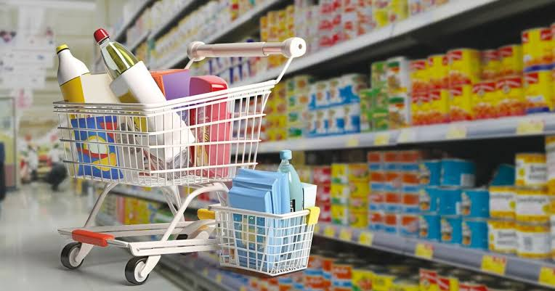
About Atliq Mart
Atliq Mart is a retail giant with over 50 supermarkets in south region of India
All their 50 stores ran a massive promotion during Diwali and Sankranti on their atliq branded Products.

Slide 3
Problem Statement
After the promotions sales director Bruce hariyali wants to understand which promotion did well and which did not
So that they can make informed decisions for their next promotional period

Slide 4
Objectives
Analyse the provided data to deliver tangible insights to the sales director
Create a dashboard which helps them to understand data easily
Perform ad-hoc requests to answer their business questions

Slide 5
Data Exploration
Data set consists of 4 files :
Dim Campaigns – consists of campaign names code and start to end date
Dim stores – consists of store ID and city details
Dim products – consists of product name , code and category
Fact events – consists of transactions data , quantity sold before and after

Slide 6
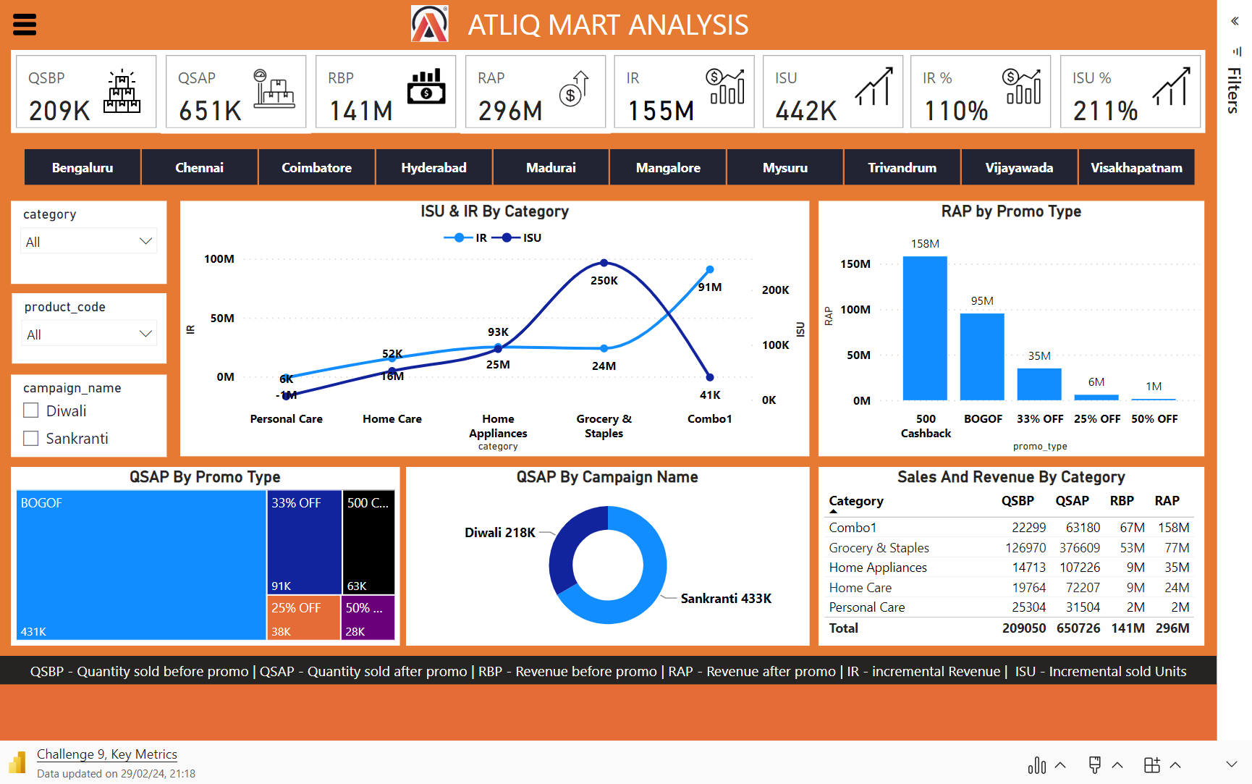

Slide 7
Key Metrics
Quantity sold before promo
Revenue before promo
Incremental Revenue
Incremental Revenue %
Quantity sold after promo
Revenue after promo
Incremental Sold Units
Incremental Sold Units %

Slide 8
Recommended Insights
Store Performance Analysis
Promotion Type Analysis
Product & Category Analysis

Slide 9
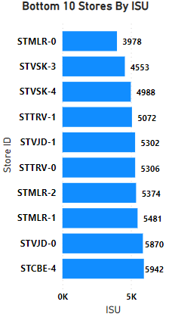
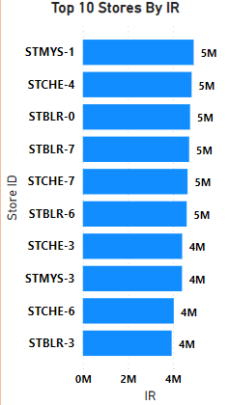
Store Performance Analysis
Top 10 stores of incremental revenue generated from promotions
Bottom 10 stores of incremental sold units from the promotions

Slide 10
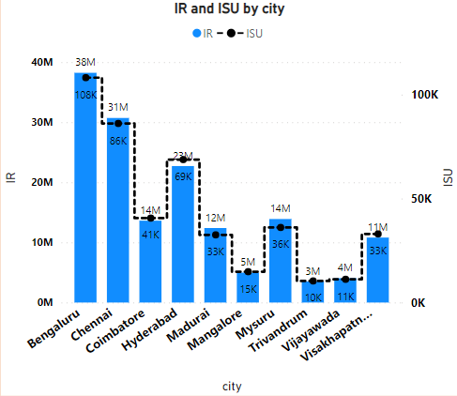
Store Performance Analysis
Performance of stores vary by city
Bengaluru stores has the highest incremental revenue and sold units
Trivandrum stores has the lowest incremental revenue and sold units
Chennai , Hyderabad , Coimbatore stores maintained good incremental sold units and revenue

Slide 11
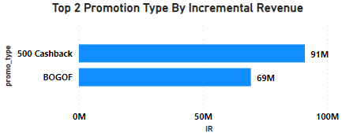
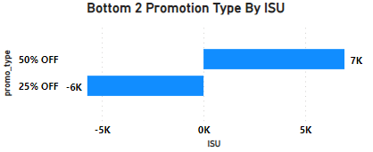
Promotion Type Analysis
Top 2 Promotions resulted in highest Incremental revenue
Bottom 2 Promotions types impact in terms of incremental sold units

Slide 12
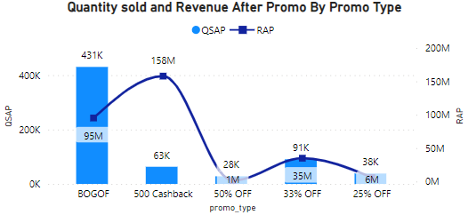
Promotion Type Analysis
Difference in the performance of Discount based vs BOGOF vs Cash Back promotions

Slide 13
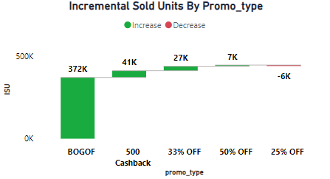
Promotional Type Analysis
Promotions strike the best balance between incremental sold units and maintaining healthy margins
BOGOF(BUY ONE GET ONE FREE) this promotion has maintained highest ISU
500 cashback and 33% off maintained healthy margins
25 % off promo type has the decrease in ISU OF -6K

Slide 14
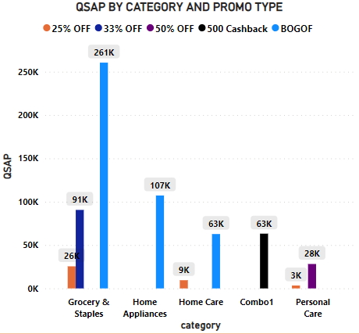
Product & Category Analysis
Product categories saw the most significant lift in sales from the promotions
Grocery & staples and Home appliances saw most significant lift in sales from the BOGOF promotion
Grocery & staples of 33% off promo type has also good sales
Home care category had good lift with BOGOF promotion

Slide 15
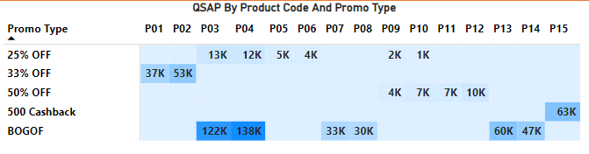
Product & Category Analysis
Specific products that responds exceptionally well or poorly to the promotions
Product code 4 and 3 has exceptionally well with 138K and 122K quantity sold in BOGOF promotion
Product code 10 has poor performed of sales in 25% off

Slide 16
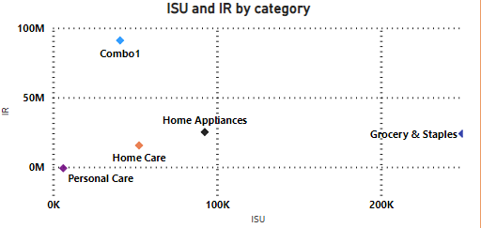
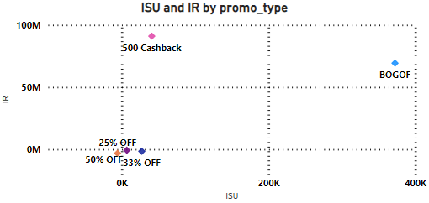
Product & Category Analysis
Correlation between product category and promotion type effectiveness

Slide 17
Ad-hoc requests

Slide 18
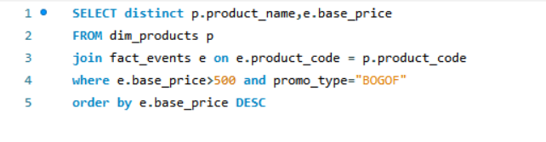

1. Provide a list of products with a base price greater than 500 and that are featured in promo type of 'BOGOF (Buy One Get One Free).
Query
Output

Slide 19
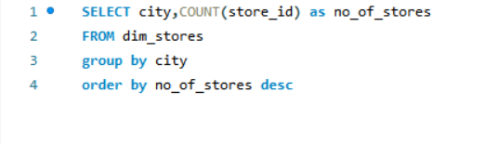
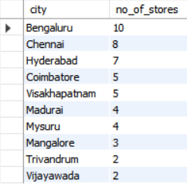
2. Generate a report that provides an overview of the number of stores in each city.
Query
Output

Slide 20
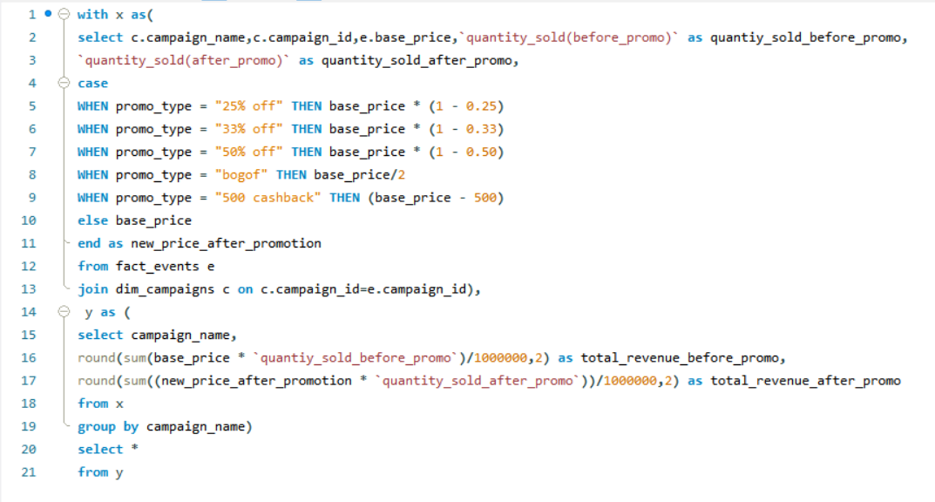

3. Generate a report that displays each campaign along with the total revenue. generated before and after the campaign
Query
Output

Slide 21
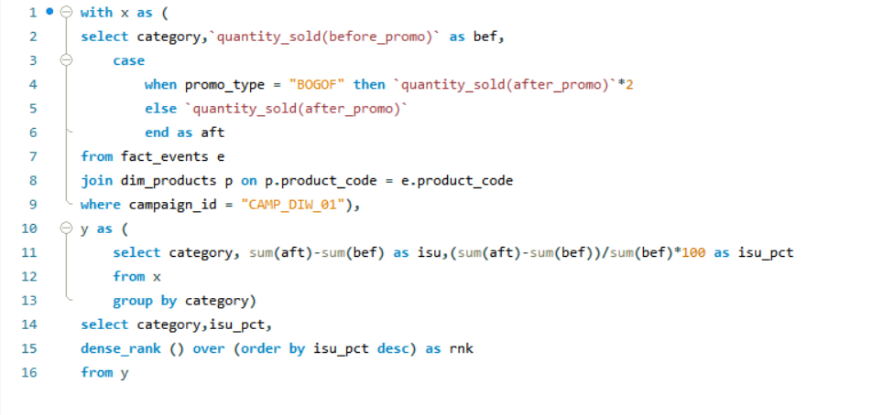
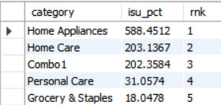
4. Produce a report that calculates the Incremental Sold Quantity (ISU%) for each category during the Diwali campaign. Additionally, provide rankings for the categories based on their ISU%.
Query
Output

Slide 22
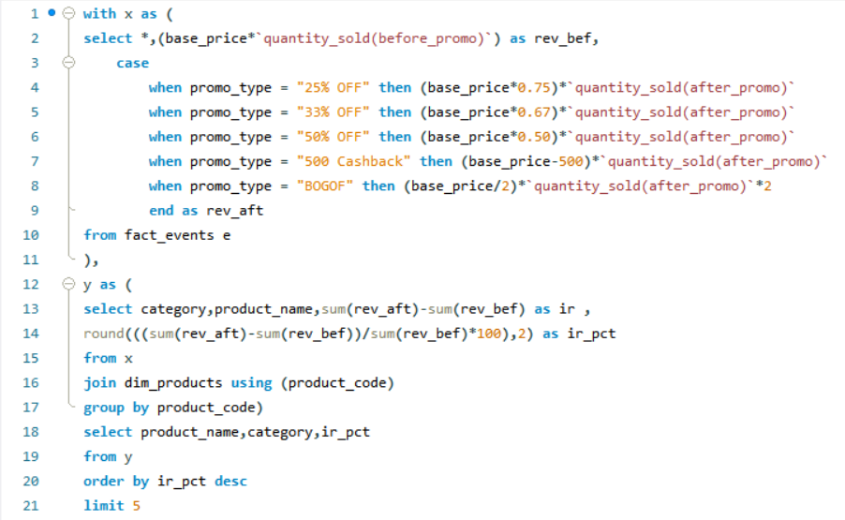
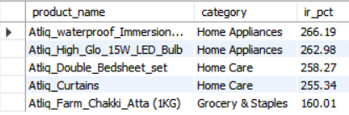
5. Create a report featuring the Top 5 products, ranked by Incremental Revenue Percentage (IR%), across all campaigns.
Query
Output

Slide 23



Dhaval Patel
Hemanand Vadivel

Slide 24
Thank You

